Slide 1

Introduction

Slide 2
Keras
Python API for Tensorflow, Theano, CNTK…
Linux, Windows, MacOS
CPU or GPU
Follows recommended practices
Simple, consistent, intuitive
Good default parameters
Fast and flexible

Slide 3
Build a model in 5 steps
# Import data
from keras.models import fashion_mnist
# Create model object
model = keras.models.Sequential()
# Specify the architecture
model.add(Dense(num_nodes, input_shape(dims,), activation = ‘relu’))
# Compile model with optimizer and loss
Model.compile(loss=‘categorical_crossentropy’, optimizer=‘sgd’)
# Train model
Model.fit(X_train, Y_train, batch_size = 128, epochs = 20 )

Slide 4
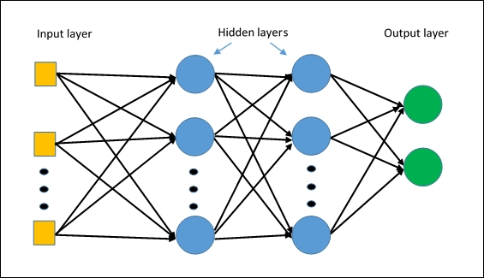
Create a model object
import keras
from keras.models import Sequential
# Create model object
model = keras.models.Sequential()
Source: http://www.oreilly.com/library

Slide 5
Specify a model architecture
How many layers? What types of layers?
First layer, last layer
Dense, Convolutional, Dropout, Pooling…
How many nodes in each layer?
Specify the number of nodes in each layer
Last layer: specifies the number of predictions
What activation function to use in each layer?
For classification, use softmax
model.add(Dense(num_nodes, input_shape(dims,), activation = ‘relu’)
model.add(Dense(num_nodes, activation = ‘relu’))
model.add(Dense(num_classes, activation=‘softmax’))

Slide 6
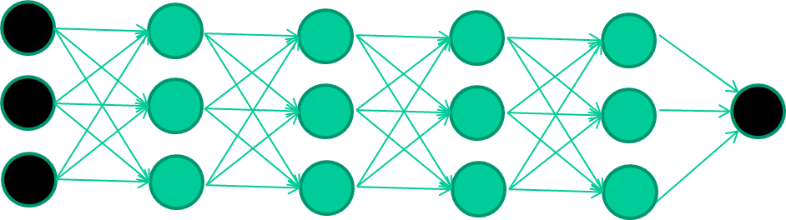
Convolutional layers
Dense layers
.16 | .90 | .36
.23 | .62 | .34
.71 | .83 | .02
.22 | .09 | .63
.32 | .26 | .43
.17 | .83 | .19
model.add(Conv2D(64, kernel_size=(3,3), activation= ‘relu’, input_shape())
model.add(Conv2D(64, kernel_size=(3,3), activation= ‘relu’)
model.add(Dense(num_nodes, activation = ‘relu’))
model.add(Dense(num_classes, activation=‘softmax’))
Filters

Slide 7
Compile a model
Optimizers
Controls the learning rate
Lots of options
Common choices: Adam, Stochastic gradient descent (SGD)
Loss functions
Lots of options
Common choices: mean_squared_error for regression and categorical_crossentropy for classification
Metrics
Review model summary
model.compile(optimizer=‘sgd’, loss=‘categorical_crossentropy’, metrics=[‘accuracy’]
model.summary()

Slide 8
Train a model
model.fit(predictors, target)
model.fit(X_train, Y_train, batch_size=128, epochs=15,
verbose=1, callbacks=
[EarlyStopping(patience=3, monitor='val_loss’)])

Slide 9
Evaluate a model
score = model.evaluate(X_test, Y_test, verbose=0)
Print (‘Test score:’, score[0])
Print(‘Test accuracy:’, score[1]
Test score: 0.14654441912919283
Test accuracy: 0.9574
Predictions = model.predict(new_data)

Slide 10
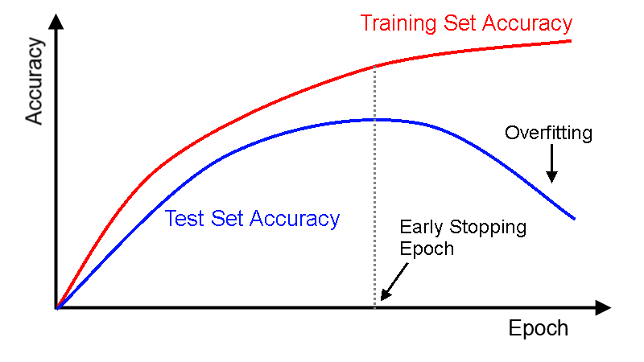
Overfitting
https://deeplearing4j.org/docs

Slide 11
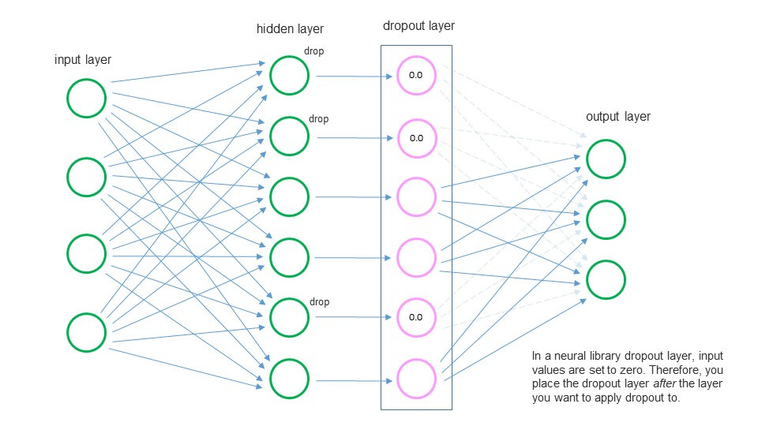
Techniques
https:// jamesmccaffrey.wordpress.com
model.add(Dropout(.50))
model.fit(X_train, Y_train, validation_split=0.2,
callbacks = [EarlyStopping(patience=3, monitor='val_loss’)])

Slide 12

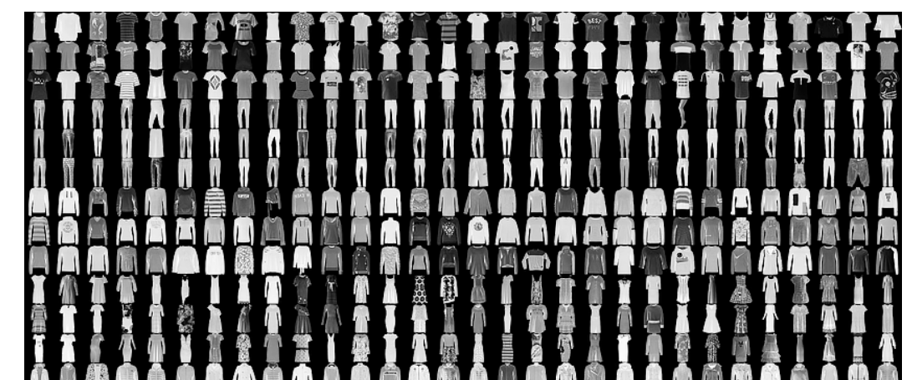
Labs
1st lab: Simple keras model (optional)
2nd Lab: Classification with Fashion MNIST data set
Build a model to recognize which fashion category an image belongs

Slide 13
Questions?

